Slide 1


Introduction to basic R
Abu Bakar Siddique Bioinformatician, SLUBI

Slide 2
Contents
About R
R vs Rstudio
Timeline
Setting a project or working directory
Interacting with R
Packages
Assign values or objects
Data types
Data structures
How to import and export data or results
Handle large data
Housekeeping
Outliers

Slide 3

Basic about R
R is ...
a programming language
a programming platform (= environment + interpreter)
a software project driven by the core team and the community
a very powerful tool for statistical computing
a very powerful computational tool in general
Yet ...
it is very elegant
it becomes more and more feature-rich
R is not ...
a tool to replace a statistician
the very best programming language
the most elegant programming solution
the most efficient programming language

Slide 4
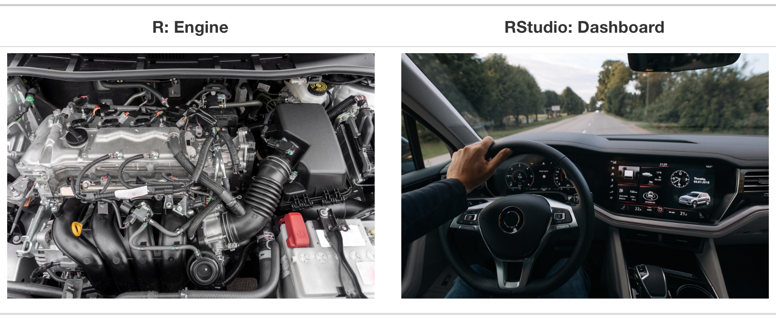
R
RStudio
Programming language
For data analysis and graphics
Refers to both the language and the software that interprets it’s scripts
Free and open source
User interface for working with R
Wrapper around the R language
Extends what R can do and facilitates writing R code
Free and open source
Notes:
You have to download them separately
Make sure to download R before installing RStudio

Slide 5




Timeline
ca. 1992 — conceived by Robert Gentleman and Ross Ihaka (R&R) at the University of Auckland, NZ as a tool for teaching statistics
1994 — initial version
2000 — stable version
2011 — RStudio, first release by J.J. Allaire
ca. 2017 — Tidyverse by Hadley Wickham

Slide 6
Setting up a project

Slide 7
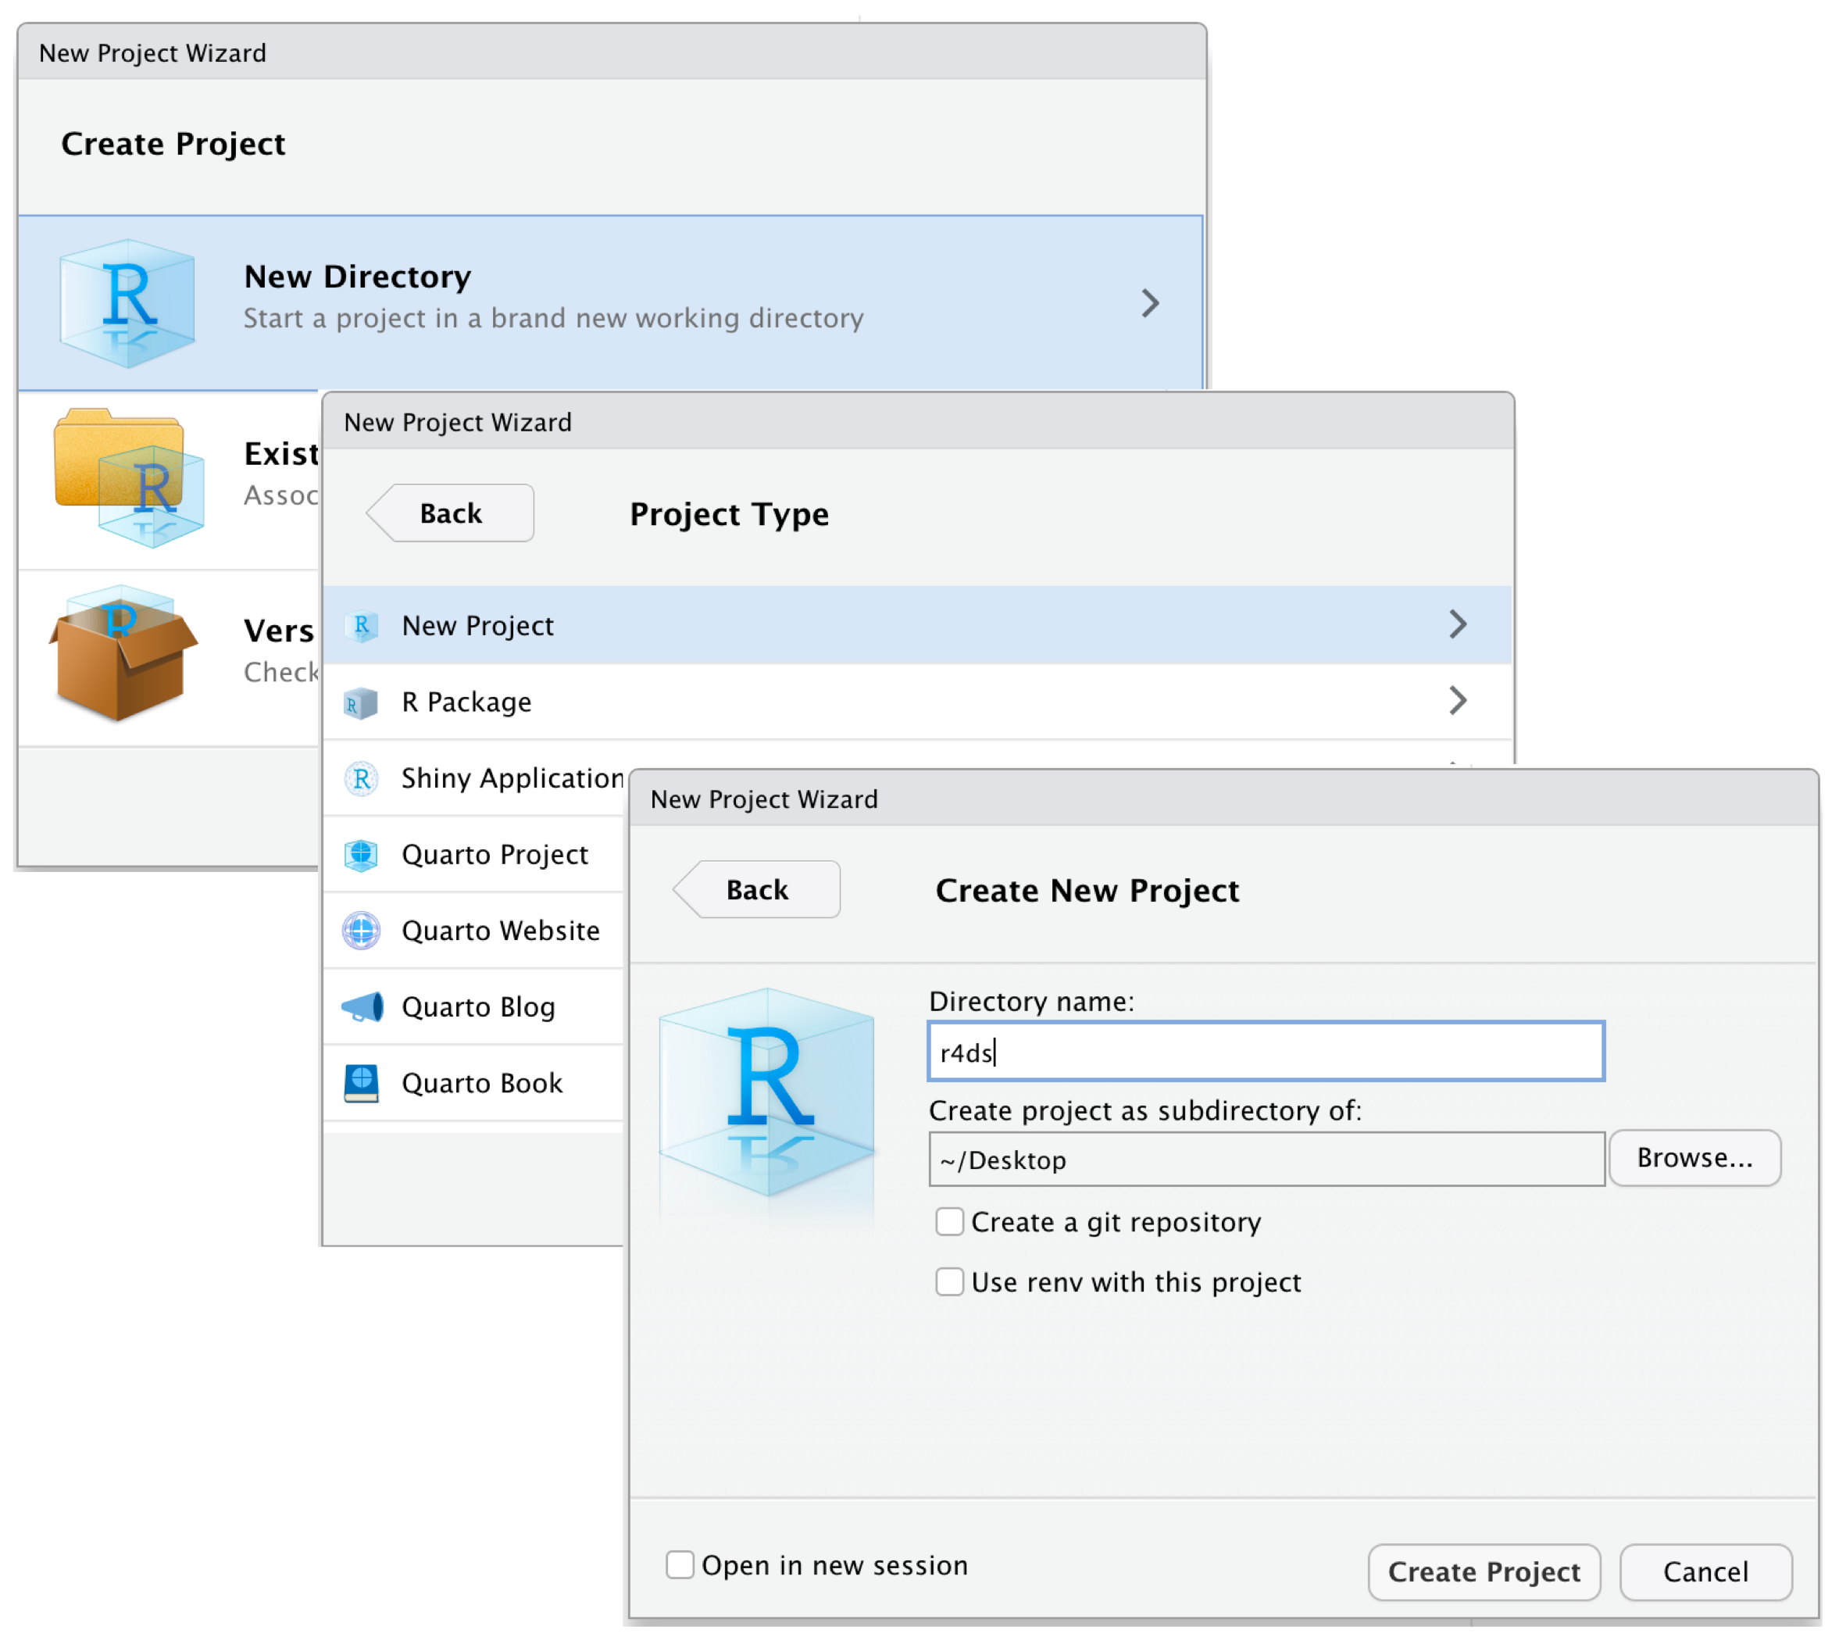
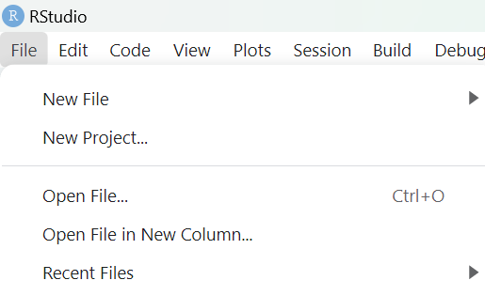

Slide 8
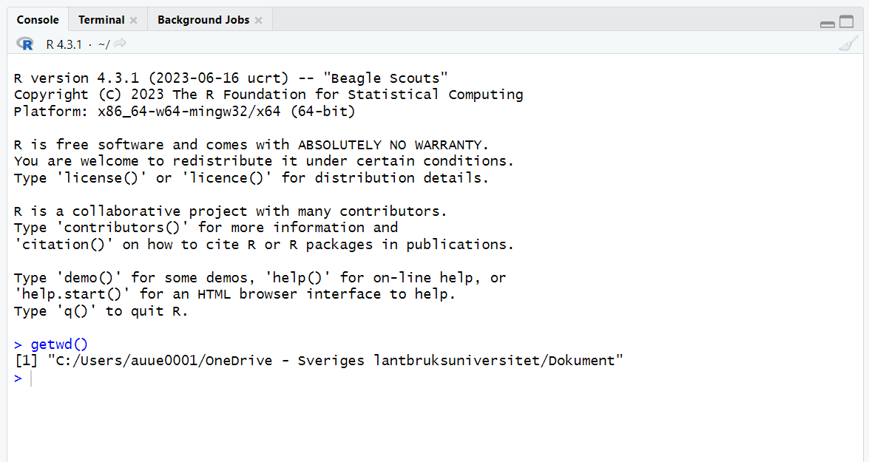
The working directory
Where R will look for and save files
Check working directory with the getwd() , setwd() functions

Slide 9
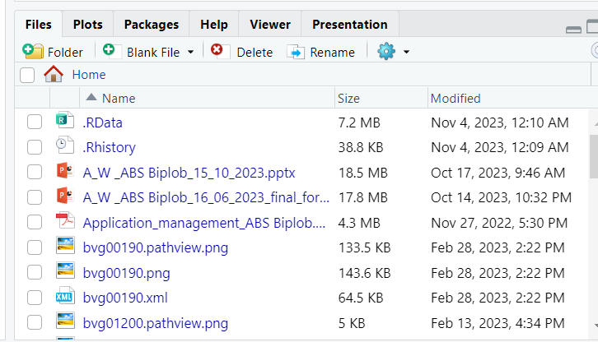
Suggested subdirectories
data/ for raw data and intermediate datasets
data_output/ modified versions of raw data
documents/ outlines, drafts, other text
fig_output/ graphics generated by scripts
scripts/ R scripts for different analyses or plotting
# create subdirectory
dir.create(path = “path_to_working_directory/data_output")

Slide 10
Interacting with R

Slide 11

Packages
developed by the community
cover several very diverse areas of science/life
uniformly structured and documented
organized in repositories:
CRAN

Slide 12
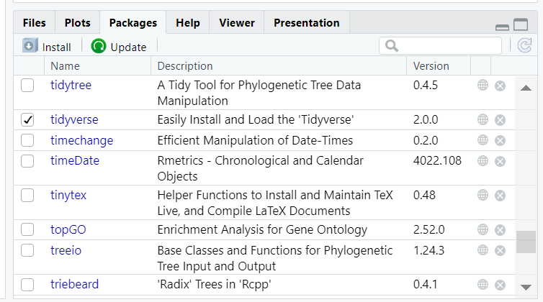
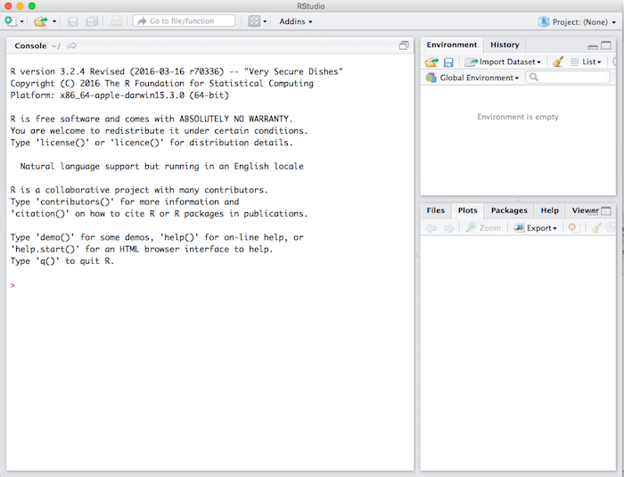
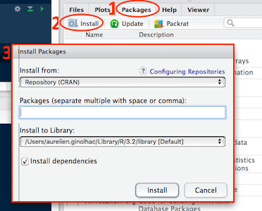
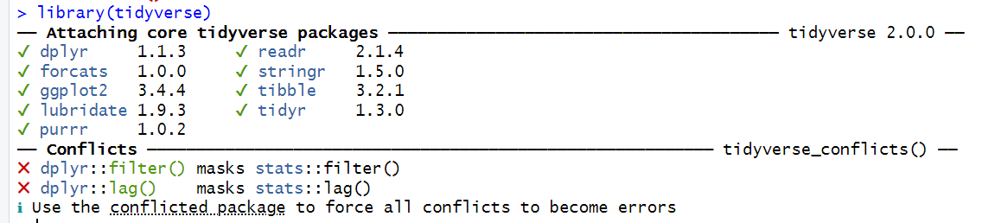
Packages
developed by the community
cover several very diverse areas of science/life
uniformly structured and documented
organized in repositories:
CRAN

Slide 13
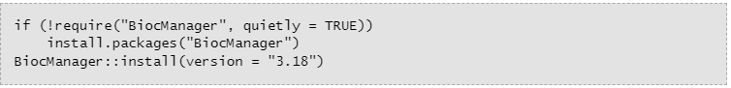
Packages
developed by the community
cover several very diverse areas of science/life
uniformly structured and documented
organized in repositories:
CRAN
Bioconductor
R-Forge
GitHub

Slide 14
Assign values to objects

Slide 15
Assign values to objects
p <- 3
x <- c(1, 6, 8)
y <- c(“car”, “truck”)
Notes:
arrow pointing at the object receiving the value of the expression.

Slide 16
Scalars, vectors and matrices

Slide 17
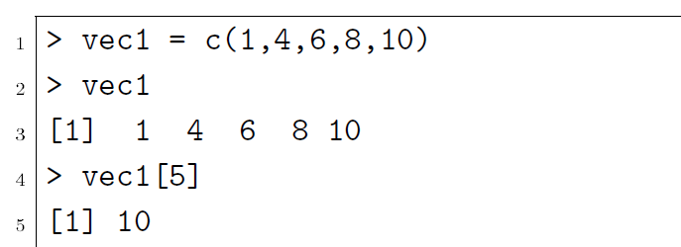
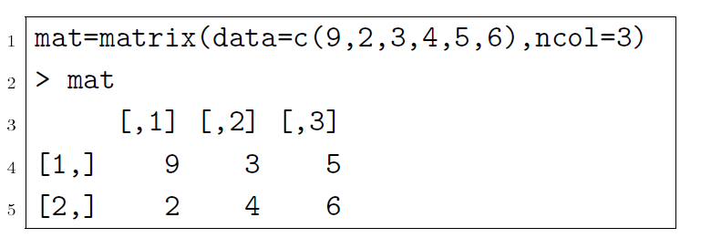
Types of vectors and objects
Scalar (0 dimention):
p <- 3
Vector (arrays -1 dimention) :
x <- c(1, 6, 8)
y <- (“car”, “truck”)
Matrix (2 dimension):
Notes:
scalars (a single number – 0-dimensional),
vectors (arow of numbers, also called arrays – 1-dimensional) and
matrices (like a table – 2-dimensional).

Slide 18
Types of vectors and objects
character: y <- (“car”, “truck”)
numeric: x <- c(1.1, 6.2, 8.4)
integer: z <- 2
logical: TRUE, FALSE
complex: 1+4i (complex numbers with real and imaginary parts)
R has many functions to examine features of vectors and other objects:,
class() - what kind of object is it (high-level)?
typeof() - what is the object’s data type (low-level)?
length() - how long is it? What about two dimensional objects?
attributes() - does it have any metadata?
Notes:
As.cah
As numeric
As intiger

Slide 19
Structures

Slide 20
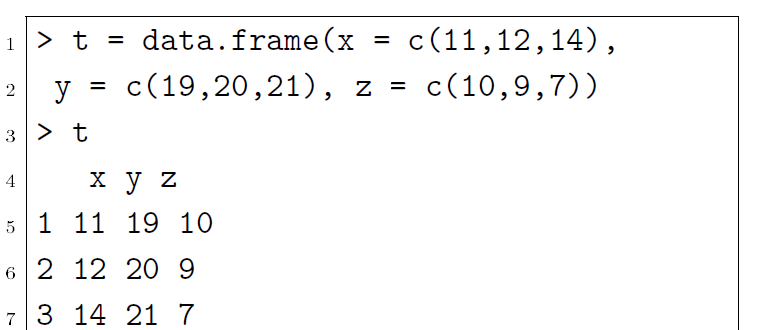
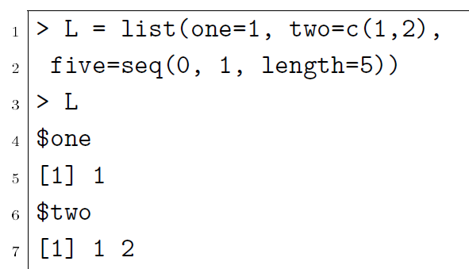
Data structures
Matrix
Data frames
Factors (r assign a level for each values)
Arrays
Lists
> x <- 1:12
> # Create a 3 x 4 array from the vector
> my_array <- array(values, dim = c(3, 4))
> # Print the array
> print(my_array)
[,1] [,2] [,3] [,4]
[1,] 1 4 7 10
[2,] 2 5 8 11
[3,] 3 6 9 12
> values
[1] 1 2 3 4 5 6 7 8 9 10 11 12
Notes:
Facotors: Factor in R is a variable used to categorize and store the data as a vector of integer values. Factor in R is also known as a categorical variable that stores both string and integer data values as levels. Factor is mostly used in Statistical Modeling and exploratory data analysis with R.
In a dataset, we can distinguish two types of variables: categorical and continuous.

Slide 21
Getting a dataset in R

Slide 22
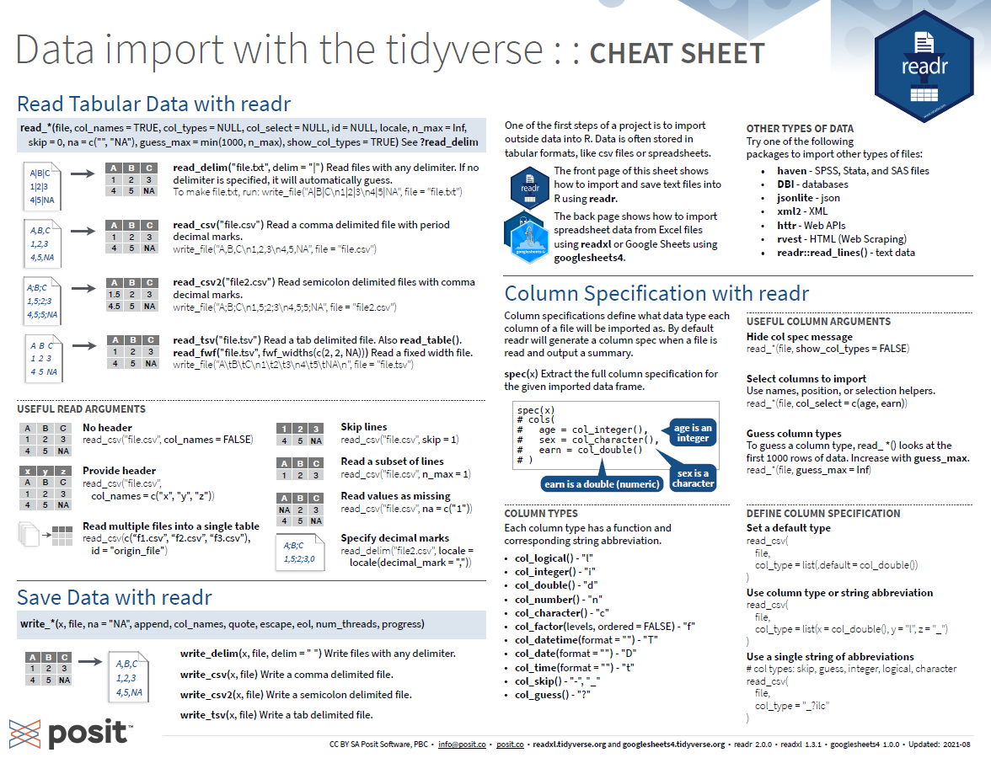
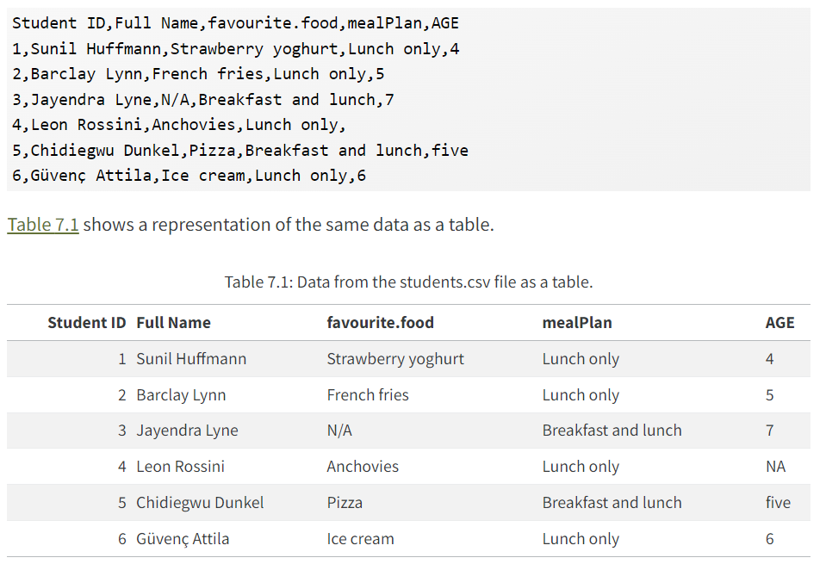
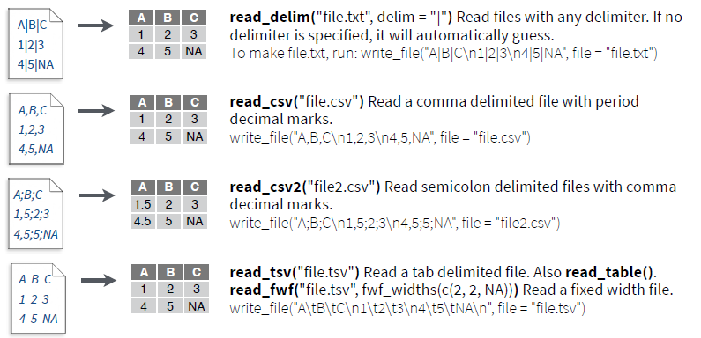
Ways to get data in R or in RStudio
Manually:
data.frame() function in Base R,
or the tibble() function in the tidyverse.
Import it from a file:
Fasta: VCF (vcfR package)
Text: TXT (readLines() function)
Tabular data: CSV, TSV (read.table() or read_delim() function or readr package which contains read_csv())
Excel: XLSX (xlsx package)
Google sheets: (googlesheets package)
Statistics program: SPSS, SAS (haven package)
Databases: MySQL (RMySQL package)

Slide 23


Slide 24
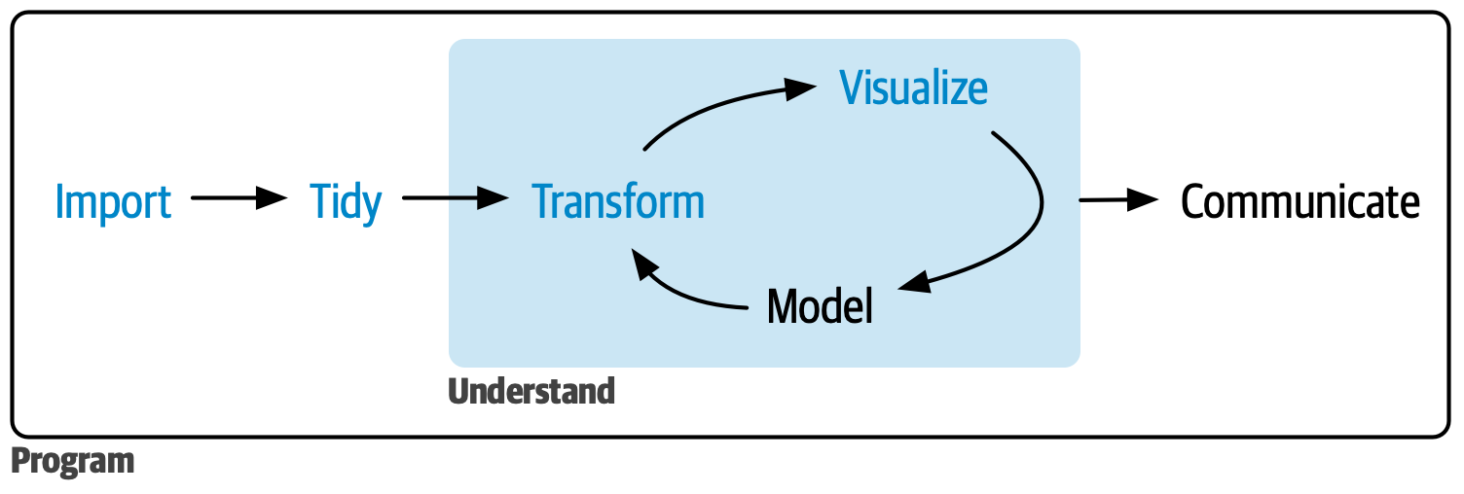
Processes

Slide 25
How to export or save as results or data
write.csv(df , file = “path/to/your/saving/folder/df.csv")
writexl::write_xlsx (test_df, path = "C:/Users/your_username/test_df.xlsx", col_names = TRUE, format_headers = TRUE)

Slide 26
How to export or save as plot
dev.print (device=jpeg, file="path/to/your/saving/plots/figure_1a.jpg", width=par("din")[1]*300, res=300, quality=100)
ggsave("path/to/your/saving/plots/figure_1a.png", plot = p1, bg ="white")

Slide 27
!! Practical session (afternoon session): read a test csv file into Rstudio!!

Slide 28
Seeking help
RStudio help interface
?sum
help.search(), with term in “” inside parentheses
Google or chatgpt “R <task>”
When asking others
Use correct words
Reduce to reproducible example
Always include output of sessionInfo() function

Slide 29

Handle large datasets

Slide 30
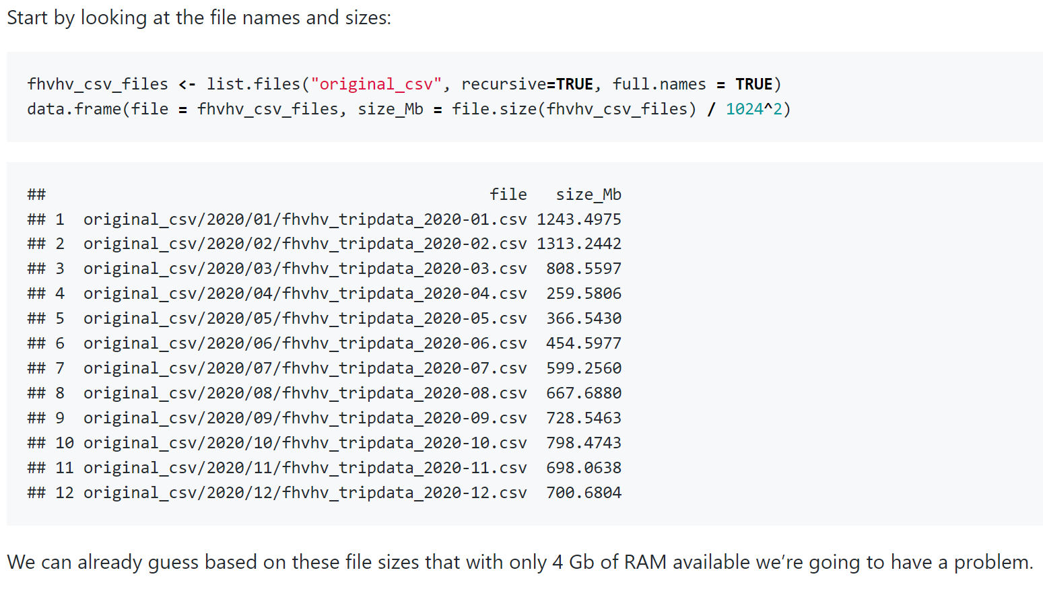
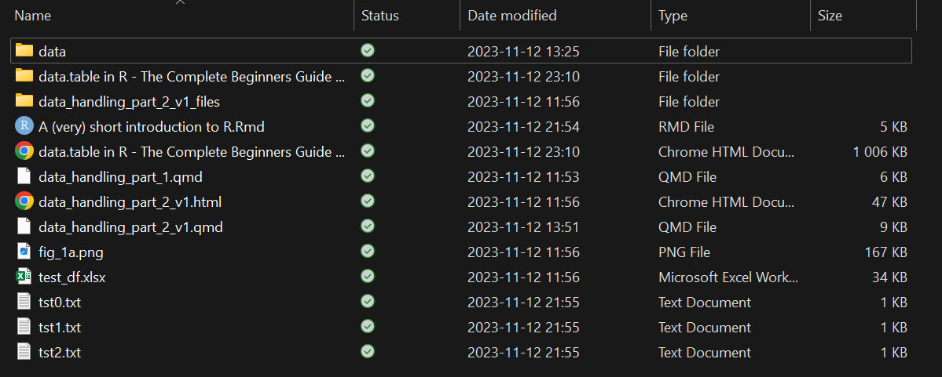
Notes:
https://hbs-rcs.github.io/large_data_in_R/

Slide 31
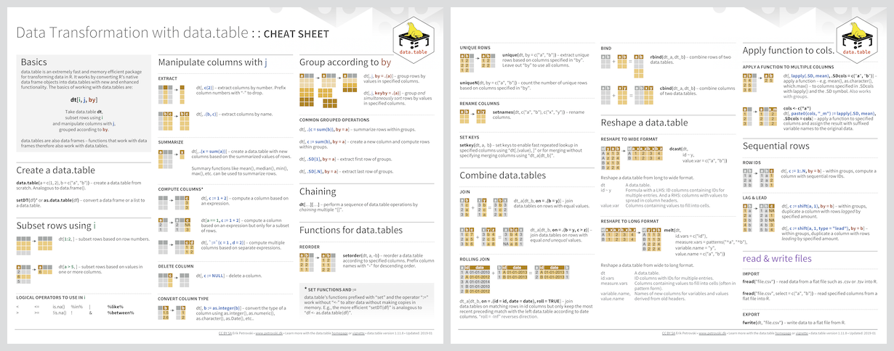
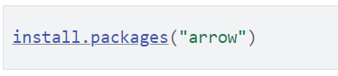
Handle large datasets
Good management strategies for large files
if you work with 10 to100 GB regularly!?
r-datatable.com
library(data.table)
R script:
firstscript.R

Slide 32
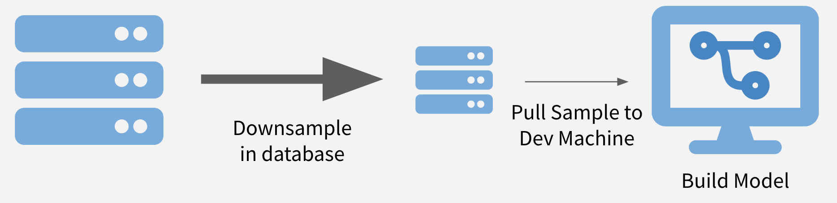
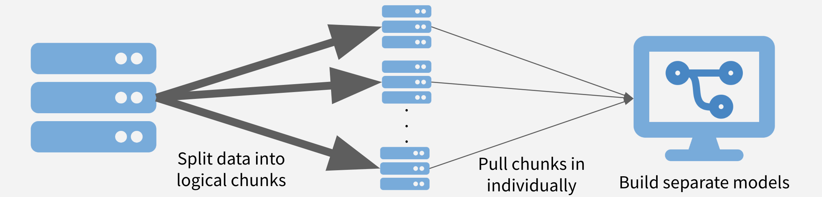
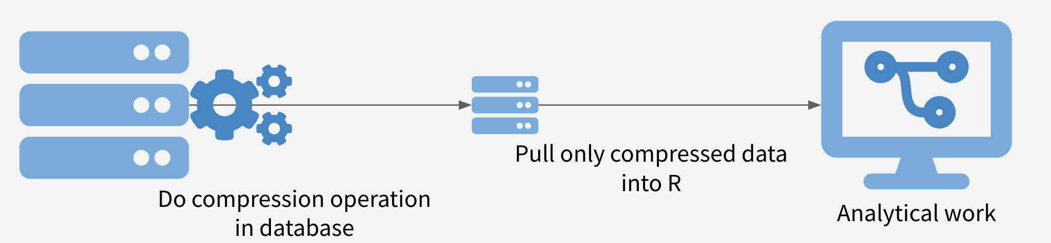
Notes:
https://rviews.rstudio.com/2019/07/17/3-big-data-strategies-for-r/
https://rviews.rstudio.com/2019/07/17/3-big-data-strategies-for-r/

Slide 33
Good housekeeping strategies for scripts
Comments, Structure:
Use #
Outline
Consistent Naming Conventions:
Use consistent naming conventions for variables, functions, and objects
Avoid duplicating code. create a function or use a loop
Version Control:
Git. Platforms like GitHub or GitLab repositories.
Imports and Dependencies:
List all package imports at the top of your script
call rhistory: sessionInfo()
File Organization:
Separate your R scripts, data, documentation, and output files into logical folders.
Reproducibility:
Use Quarto, R Markdown Documents:
Documentation Files:
Create README files

Slide 34

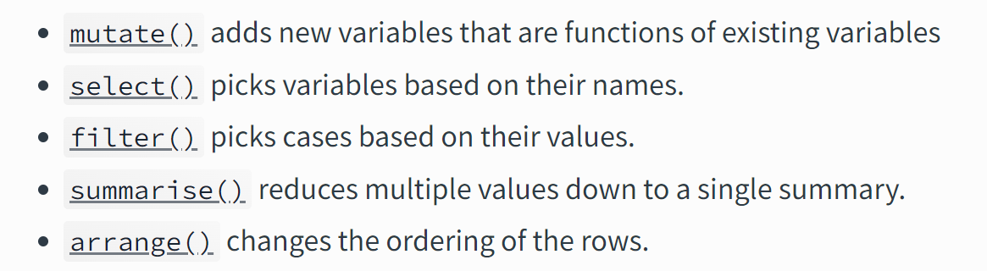
Filtering of genotype data
Subset data, metadata
Based on “rows (observations)” , “variable” or “values”
Filter
Missing data (“NA”, stat, summary)
height_sub_12 <- subset(data, height<12)
data_filter_na <- data[!is.na(data$height),]

Slide 35
Conversion of different genotype file formats
Common programs used to handle the file formats:
Hapmap: library(plink), library(VariantAnnotation)
Numeric: library(readxl, writexl), library(jsonlite)
Haploid format – one letter code (readLines function)

Slide 36
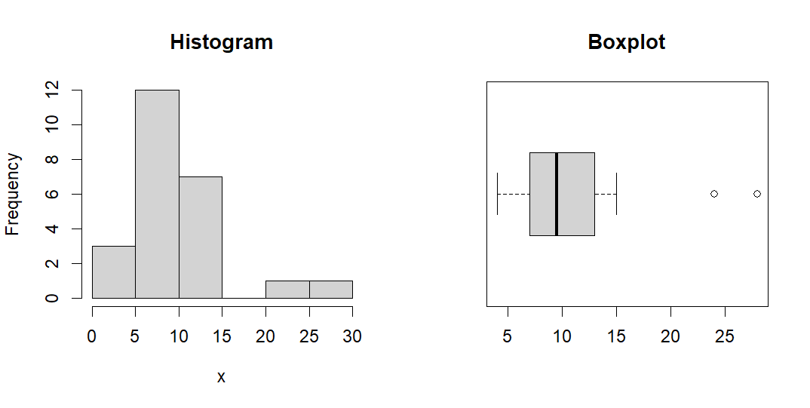
Outliers in genotype and phenotype datasets
Histogram, scatterplot, and boxplot, Q-Q plot, chi square test
x = c(10,4,6,8,9,8,7,6,12,14,11,9,8,4,5,10,14,12,15,7,10,14,24,28)
Notes:
https://www.itl.nist.gov/div898/handbook/prc/section1/prc16.htm
https://www.reneshbedre.com/blog/find-outliers.html#mean-and-standard-deviation-sd

Slide 37
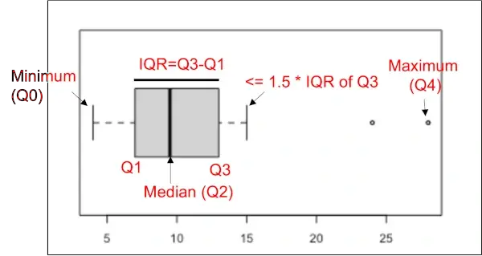
Outliers in genotype and phenotype datasets
Histogram, scatterplot, and boxplot, Q-Q plot, chi square test
IQR
x = c(10,4,6,8,9,8,7,6,12,14,11,9,8,4,5,10,14,12,15,7,10,14,24,28)
# get values of Q1, Q3, and IQR
summary(x)
Min. 1st Qu. Median Mean 3rd Qu. Max.
4.00 7.00 9.50 10.62 12.50 28.00
# get IQR
IQR(x)
[1] 5.5
# get threshold values for outliers
Tmin = 7-(1.5*5.5)
Tmax = 12.50+(1.5*5.5)
# find outlier
x[which(x < Tmin | x > Tmax)]
[1] 24 28
# remove outlier
x[which(x > Tmin & x < Tmax)]
[1] 10 4 6 8 9 8 7 6 12 14 11 9 8 4 5 10 14 12 15 7 10 14
Notes:
The interquartile range (IQR) is a difference between the data points which ranks at 25th percentile (first quartile or Q1) and 75th percentile (third quartile or Q3) in the dataset (IQR = Q3 - Q1).
https://www.itl.nist.gov/div898/handbook/prc/section1/prc16.htm
https://www.reneshbedre.com/blog/find-outliers.html#mean-and-standard-deviation-sd

Slide 38
Questions?!

Slide 39
Acknowledgements
NBIS(RaukR)
Shannon Alexandra Sheridan

